Slide 1

Twitter Sentiment on VGX
Presented by Adam Curry
Bellevue University DSC680 – Applied Data Science

Slide 2
Presentation Format
Domain – What domain is this data going to come from?
Data Used – Where did the data come from? What variables were used?
Research Questions – What questions will be answered from this analysis
Data Prep – What was the data preparation process?
Methods – What methods were used?
Findings – What did the sentiment analysis reveal?
Conclusion – What’s next?

Slide 3
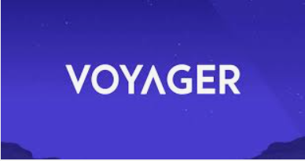
Domain
Cryptocurrency and Altcoins - Voyager (VGX)
Cryptocurrency has received a lot of attention in 2021
Social media is an indicator for health of market
Voyager is a crypto trading platform
Voyager Token (VGX)
Notes:
Cryptocurrency has received a lot of attention in 2021
States have put in legislation to regulate Bitcoin [1]
El Salvador has adopted Bitcoin as legal tenure [2]
companies have even begun accepting crypto as payment [3]
Social media is an indicator for health of market
Some experts indicate that social media can predict crypto market [4].
Voyager Digital is a cryptocurrency trading platform where users can invest in, swap, and trade cryptocurrency
Think of it as a lesser known Coinbase application
VGX(Voyager Token) is an alternative coin (altcoin) to Bitcoin.
Voyager offers loyalty benefits including interest on popular coins such as Bitcoin 3%, Ethereum 5%, USDC 9% for holding their VGX token [5]

Slide 4

Data Used
Tweet Examples:
We kinda crushed it at @investvoyager this month. Here's what happened!
#investvoyager\n\nhttps://t.co/ycQuQ4ZjVe
ðŸ¤ªðŸ¤ªðŸ¤ªðŸ¤ªðŸ¤ª Yes I want $VGX to grow!
Where did the data come from? What variables were used?
Twitter data scraped with snscrape.modules.twitter
Variables – Twitter ID, the date/time it was Tweeted, and unstructured plain text Tweet
Notes:
Where did the data come from? What variables were used?
The dataset was gathered using a Python library called using snscrape.modules.twitter.
three variables were used: Twitter ID, the date/time it was Tweeted, and the unstructured plain text Tweet.
Some Tweets are easily understood, others required some cleanup done in the data prep stage as can be seen in the Tweet Examples on the right

Slide 5
Research Questions
What questions will be answered from this analysis
Has the token’s popularity increased over the last two and a half years?
What is the sentiment of the Voyager Token on Twitter over the last two and a half years?
Do people associate their loyalty program with a positive or negative sentiment (i.e., is their business model favorable among Twitter users)?
Has the sentiment increased in a favorable direction with the recent crypto bull market?
What topics are most discussed concerning Voyager Digital?

Slide 6
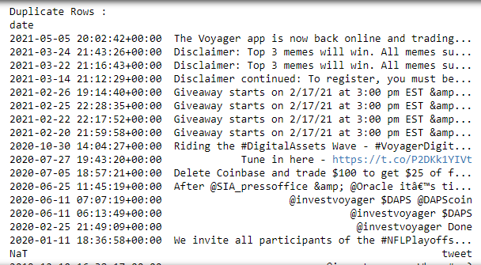
Data Prep
What was the data preparation process?
Remove punctuation and special characters
Bot Cleanup
Removing Stop words
Apply lemmatization
Notes:
The data cleanup process included removing stop words, punctuation, lowercase words, removing special characters from the string with regular expressions.
I added a “bot cleanup” process. It wasn’t the most sophisticated, but it was effective. The image on the right shows many duplicate Tweets. When it comes to crypto, bots are often deployed to influence a coin on social media in an attempt to drive up the price.
The final data prep stage was to apply lemmatization to the strings in an attempt to bring the words to their most basic form.

Slide 7
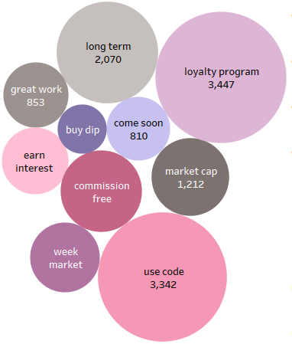
Methods
What Methods were used?
Topic modeling with sklearn
Sentiment Analysis (2 approaches)
vaderSentiment.vaderSentiment
nltk.sentiment.vader
13 Tweets were different
Notes:
Using sklearn, I was able to vectorize the words to create the topics shown in the bubble chart.
Each word/phrase shows how often it appeared in the dataset.
The loyalty program showed up 3,447 times, long term 2,070.
Some bubbles are missing frequency counts, but you get the idea.
The sentiment analysis was done two ways, both used the Vader algorithm from NLTK one using vaderSentiment.vaderSentiment and the other nltk.sentiment.vader
The Vader algorithm was designed specifically for social media sentiment analysis, so it was the perfect candidate for this analysis.
Comparing the two algorithms showed 13 Tweets that weren’t classified the same.
In the end, I went with nltk.sentiment.vader as it appeared to be the most accurate

Slide 8
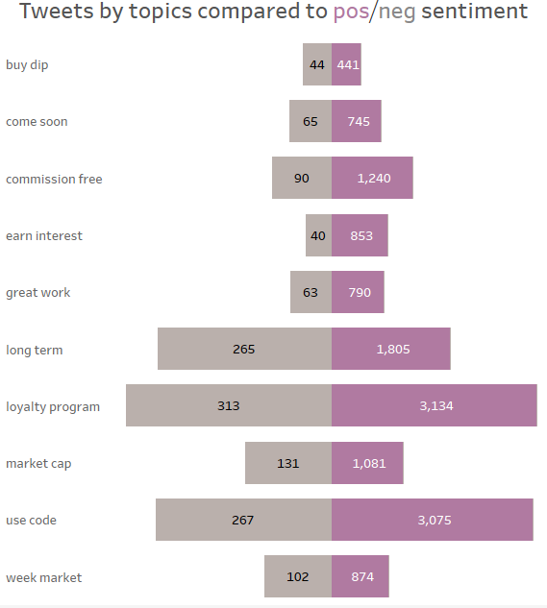
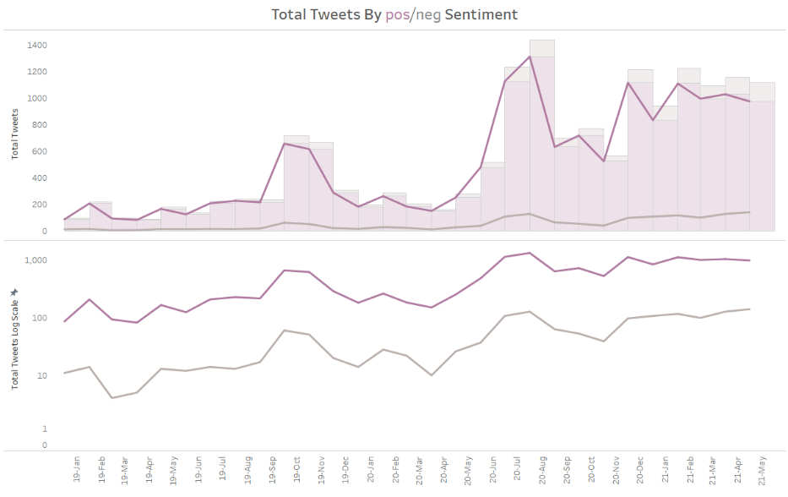
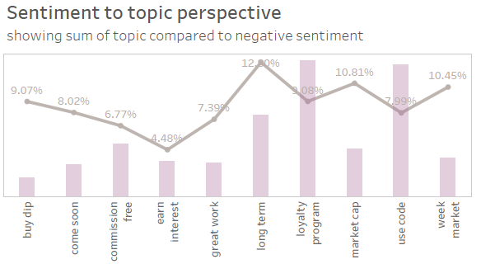
Findings
Notes:
Diving into the sentiment analysis revealed that Tweet frequencies move in similar patterns with positive sentiment.
The left chart shows two charts:
The top shows positive and negative Tweets moving in similar patterns, increasing as the year went on. A clear finding that the coin’s popularity has increased in the last 2 ½ years. The top chart also shows a clear indication that the positive is the dominant sentiment
The log transformed graph just underneath shows patterns of movement of negative and positive sentiment. As you can see, they are both near identical trend lines
The middle graph visualize how the topics compared to the sentiment of the Tweet.
The left grey sections display the frequency of the negative sentiment related to the topic
The right display the frequency of the positive sentiment related to the topic
“loyalty program” appears to have received the highest number of positive Tweets sitting at 3,134
This seems to indicate the loyalty program has a favorable sentiment
The loyalty program also received the highest negative sentiment. However, looking at percent of total tells a different story
The chart on the right shows the frequency of each topic compared to the negative sentiment as a percent of total per topic. This puts the topics into perspective
For example, “long term” has the highest percentage of negative Tweets by topic at 12.8%.
“earn interest” received the lowest percent of negative tweets, with 4.48% and 95.52% positive tweets.
This chart seems to indicate the loyalty program received a relatively low ratio of negative Tweets, as did “earn interest”
These could be strong indicators that the company’s loyalty program, which gives their users the ability to “earn interest” are favorable among Twitter users.

Slide 9
Conclusion
Notes:
The final analysis produced findings that make intuitive sense for this domain. The Voyager Token is gaining popularity, with a very positive sentiment among Twitter users.
To take this analysis to the next level would require supplemental datasets, including
historical crypto price points
Indicators of company milestones, which would require a manual review of major company announcements.
Applying these additional variables will help find correlation between variables and see how the data move.

Slide 10

Questions?
Notes:
QUESTION:
1 – Why didn’t you use the Twitter API?
I didn’t try using tweepy as I was afraid I wouldn’t be able to get enough data. snscrape seemed to be more effective for this task.
2 - What is the benefit of snscrape?
Snscrape library scrapes the text from Twitter, which doesn’t bog down API calls https://betterprogramming.pub/how-to-scrape-tweets-with-snscrape-90124ed006af
3 -What library did you use in your preprocessing steps?
With help from the NLTK library, I was able to vectorize the unstructured data
4 - Why did you lemmatize instead of apply stemming?
Lemmatization brings the words within the string to their most basic form of language. I’ve also learned it is more effective in NLP and should be used when it isn’t overly expensive.
5 - Did you use n-grams in your topic model?
Initially I used a single ngram,. However, I eventually settled on 2,3 ngrams to produce multiple words within a single topic
6 - Were you able to apply machine learning to get an accuracy score on your sentiment analysis?
No machine learning was applied. The sentiment analysis was done on the entire population. I could’ve manually reviewed several of the Tweets to classify them prior to running through the sentiment analysis, but this would require a significant amount of time.
7 - Was there any EDA conducted in your analysis?
A true exploratory analysis was not conducted in this presentation. The extent of the analysis included graphs to show surfaced level relationships between sentiment and the topics.
8 - Why did you choose to use two different methods for your sentiment analysis?
This was more of a gut check. I wanted to ensure the sentiment I found was accurate if I ran two separate ways, as I had no way to run any sort of machine learning since the Tweets weren’t pre-classified. In other words, the only way I could classify the Tweets were to manually read them myself.
9 - Have you made any price predictions on the dataset?
With added datapoints and price points, predictions could be made on coins based on Twitter chatter. None have been made up to this point.
10 - Did you have a large enough dataset to feel comfortable with your final analysis?
A larger dataset could make this analysis more robust. Unfortunately, this is a newer company in an already heavily saturated market of products. In other words, time and more data are required to take this analysis to the next level.

